Slide 1
Contractual information
This presentation was prepared for the Institute of Education Sciences (IES) under Contract ED-IES-17-C-0004 by the Regional Educational Laboratory (REL) Appalachia administered by SRI International. The content of the presentation does not necessarily reflect the views or policies of IES or the U.S. Department of Education nor does mention of trade names, commercial products, or organizations imply endorsement by the U.S. Government.
The original version of the presentation can be found on the REL Appalachia website: https://ies.ed.gov/ncee/edlabs/regions/appalachia/events/materials/10-13-21_HWC-implementation_presentation_acc.pdf
If you plan to use these slides to facilitate a training or professional development session, please retain this disclaimer at the beginning of the presentation, even if you choose to add your organization’s logo or make revisions to the slides to meet the needs of your audience. In the occurrence that changes are made, please add a note that: Amendments to the original slides have been made as necessary in order to specifically address the purpose of this presentation.

Slide 2
How to use these slides
District and/or school leaders can use this slide deck to introduce school teams to the Handle With Care (HWC) program and to using the materials to monitor implementation and student outcomes on a regular basis.
It should take approximately one hour to review the information included in this slide deck.
This slide deck includes 11 sections:
  Welcome and Background
  Overview of the Handle With Care Program
  Handle With Care Implementation in Schools
  Data Sources for Monitoring Handle With Care Implementation
  The Handle With Care School Team
  Monitoring Handle With Care Data
  Materials to Support Handle With Care Data Monitoring
  Preparing for a Handle With Care Data Review Meeting
  Getting Started
  Tips for Program Implementation
  Wrap-up
Notes:
Facilitator notes:
This slide is provided for information for the trainer/facilitator only. Please remember to delete this slide prior to using with a training group.

Slide 3
Monitoring Handle With Care (HWC) Implementation and Student Outcome Data
Presenter name
Presenter title
Date
Notes:
Facilitator notes:
Update this slide with presenter(s), title(s), and date. Read the title.

Slide 4
Welcome and Background
Notes:
Facilitator notes:
Welcome participants to the meeting.

Slide 5
What brings us here today?
In 2013, the West Virginia Center for Children’s Justice (WVCCJ) created the Handle With Care (HWC) program. HWC fosters collaboration among various local agencies to help support students who may have experienced trauma.
In 2018, WVCCJ partnered with Regional Educational Laboratories Appalachia (REL AP) and the West Virginia Department of Education (WVDE) to develop materials to support schools that implement HWC with data monitoring and data use for continuous improvement.
This presentation provides an orientation to the materials available for monitoring Handle With Care data and to processes for facilitating decisions/next steps towards improving student outcomes.
Notes:
Facilitator notes:
Read through bullet points.

Slide 6
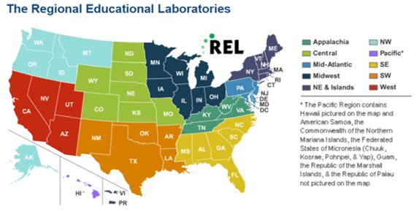
Project background: The Regional Educational Laboratories
Notes:
Facilitator notes:
Read talking points.
Talking points:
The materials we will discuss today were developed as part of a project through the Regional Educational Laboratory program, administered by the U.S. Department of Education, Institute of Education Sciences. There are 10 federally funded labs across the United States that are tasked with linking practitioners to education research that can improve practice.​
​
The content of this presentation was developed under the Regional Educational Laboratory (REL) Appalachia at SRI International. Under the REL program, there are three main activities staff conduct:​
Disseminate findings from research in ways that educators and policymakers can use in practice.​
Provide educators and other stakeholders with training, coaching, and technical support needed to use research findings and evidence in the classroom—to improve teaching and learning.​
Conduct a wide variety of applied research studies.​

Slide 7
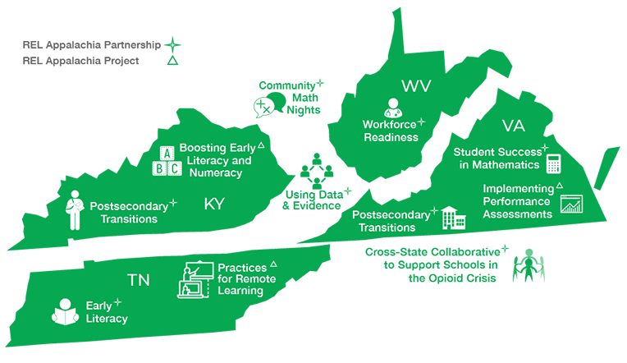
Project background: REL Appalachia regional partners
For more information about this work, visit: https://ies.ed.gov/ncee/edlabs/regions/appalachia/
Notes:
Facilitator notes:
Read talking points.
Talking points:
REL Appalachia supports stakeholders in Kentucky, Tennessee, Virginia, and West Virginia. The content of this presentation was developed in collaboration with partners and stakeholders in those states to address issues of importance to them, which are shown in this map. One of the projects under REL Appalachia is the Cross-State Partnership, whose goal is to help address data-rich, information-poor (DRIP) syndrome by improving local data users’ understanding and use of data for strategic planning, continuous improvement, and decisionmaking. The Cross-State partners decided to allocate REL Appalachia resources to intensive support for West Virginia stakeholders to create model products for use across all four states in the region. West Virginia stakeholders identified Handle With Care (HWC)—a freely available program to support students impacted by trauma—as the intervention of interest. Over the past three years, REL Appalachia staff worked closely with stakeholders and local educators in West Virginia to develop a portfolio of materials to support educators to monitor HWC program implementation and select student outcome data including attendance rates, behavior incidents, and student achievement. We will be discussing this portfolio of materials during our time together today.
Although the materials we will discuss today are tailored for use with Handle With Care, the approach to monitoring implementation, analyzing data, and engaging in reflection and planning next steps can serve as a model for school staff when implementing other programs as well. For example, after implementing this approach with the Handle With Care program, one district applied this continuous improvement approach to their Multi-Tiered Systems of Support (MTSS) processes.

Slide 8
Today’s focus
  Learn about the materials and processes that support HWC implementation and the monitoring of HWC data in your district or school, and
  Focus on data use to support continuous improvement when implementing HWC in the school setting.
Notes:
Facilitator notes:
Read bullet points.
Talking points:
This presentation is not intended to provide a comprehensive overview of HWC. Rather, it is intended to focus on providing information on how schools can use the materials co-developed by WVCCJ, REL AP, and WVDE to use data to monitor progress and use data for decisionmaking with the aim of improving student outcomes.

Slide 9

Agenda
Welcome and background
Overview of the Handle With Care Program
Handle With Care Implementation in Schools
Data Sources for Monitoring Handle With Care Implementation
The Handle With Care School Team
Monitoring Handle With Care Data
Materials to Support Handle With Care Data Monitoring
Preparing for a Handle With Care Data Review Meeting
Getting Started
Tips for Program Implementation
Wrap-up
Notes:
Facilitator notes:
Read through agenda.

Slide 10
Overview of the Handle With Care Program
Notes:
Facilitator notes:
Read talking points.
Talking points:
In this section, we will answer the following question:
What is the HWC program and why is it important?

Slide 11
The problem
Students may experience trauma as a result of their exposure to events or incidents that occur at home or in the community, such as domestic violence, drug overdoses, and systemic issues like racial injustice or the COVID-19 pandemic.
Such students have increased risk for negative outcomes such as poor academic performance, emotional and behavior problems, dropping out of school, and delinquency.
Adapted from Handle With Care Overview, West Virginia Center for Children’s Justice. http://handlewithcarewv.org/handle-with-care.php
Notes:
Facilitator notes:
Read slide content.

Slide 12
How can HWC help?
HWC is a school-community partnership program founded in 2013 to provide students exposed to trauma in their homes, schools, or communities with appropriate supports to help them succeed.
If local law enforcement, emergency management services, and fire departments notify school staff when a student is present at the scene of any incident, and
If school staff have training and resources to recognize and support symptoms of trauma in students they serve,
Then they can identify students who need interventions and provide appropriate supports or refer them to mental health services,
Thus, improving students’ behavioral, social-emotional, and academic outcomes.
Notes:
Facilitator notes:
Read slide content and the theory of change in the arrow (left to right), then read talking points.
Talking points:
The ultimate goal of the Handle With Care program is to support children and students. REL Appalachia collaborated with the West Virginia Center for Children’s Justice to document the theory of change for Handle With Care. The theory of change posits that developing collaboration between local organizations and schools helps inform educators about potentially traumatic events that have occurred in students’ homes or communities that may impact their learning and engagement in school, and providing educators with training and resources on trauma-informed strategies helps equip educators to better serve all students, including those experiencing trauma.

Slide 13
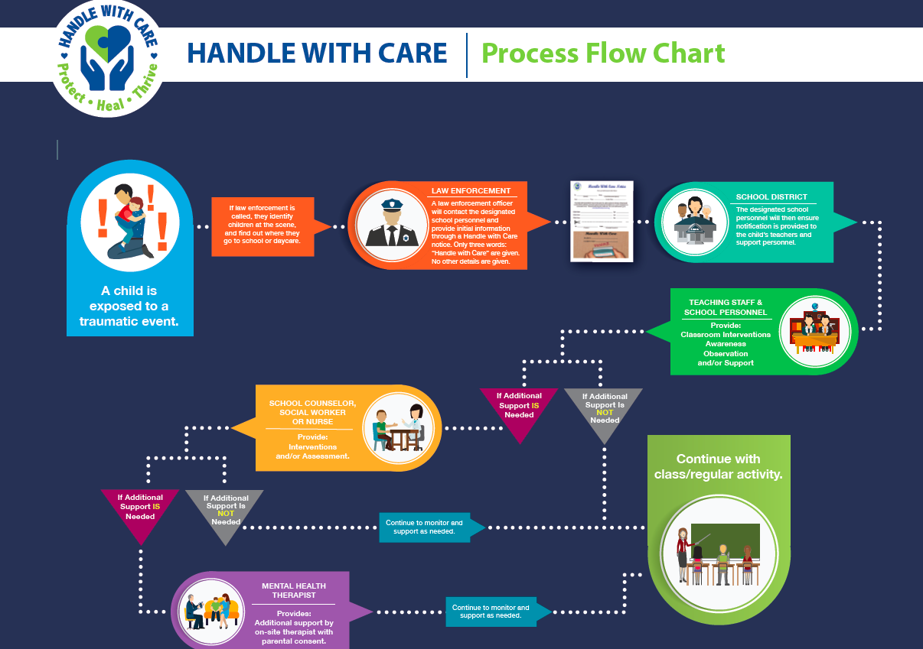
HWC implementation process
Source: http://www.handlewithcarewv.org/docs/Handle%20WIth%20Care%20Flow%20Chart.pdf
Notes:
Facilitator notes:
Reading talking points and review diagram.
Talking points:
Handle With Care promotes school-community partnerships aimed at providing children who are exposed to trauma in their homes, schools, or communities with appropriate supports, including interventions if necessary. The ultimate goal of HWC is to help students succeed in school. Regardless of the source of trauma, the common thread for effective intervention is the school or childcare agency. This slide provides an overview of the HWC implementation process. Prior to implementation, school staff and law enforcement personnel, emergency medical services (EMS), and the fire department participate in an HWC one-hour training and follow-up book study.
[Facilitator reviews HWC implementation process as shown on the slide.]

Slide 14
Handle With Care Implementation in Schools
Notes:
Facilitator notes:
Read talking points.
Talking points:
You’ve learned about the Handle With Care program, its goals, and how it can help students. In this section, we will answer the following question:
What does Handle With Care look like in schools?

Slide 15



Implementing the HWC program in schools
A school or district contact receives the HWC notice from law enforcement and/or other first responders.
The school contact informs the appropriate teachers and school staff (e.g., school counselors, nurses) about the notice.
Teachers and school staff observe the student to determine whether the student needs additional support and offer appropriate trauma-sensitive support as needed.
Notes:
Facilitator notes:
Read talking points. Add additional information relevant to your local context around how HWC notices are shared with district and school staff.
Talking points:
After a first-responder identifies a student at the scene of an incident and creates a HWC notice, a school or district contact receives that HWC notice. Once the school or district contact knows the name of the student identified for HWC support, the contact shares the notice with the appropriate teachers and school staff (usually the student’s classroom teachers, school counselors, and nurses, though this may include other staff who work closely with the student). Finally, teachers and other school staff observe the student and determine whether the student needs additional support, such as a meeting with a school counselor. Teachers and other school staff also use trauma-sensitive strategies to support students as needed, such as checking in with the student or allowing the student time to calm down in a quiet place.

Slide 16


Using HWC data to learn more about HWC in your school
Districts and schools may want to regularly monitor program data.
Monitoring HWC data will help school leaders and teachers:
Identify trends (if any) in data across different groups of students over time,
Learn more about staff professional development needs related to supporting students experiencing trauma,
Ensure supports are in place to help students succeed, and
Plan for how to use resources to address pressing needs, such as additional staffing and professional development.
Implementation Data
Information related to how teachers and other school staff carry out the HWC program.
Student Outcome Data
Information on student attendance, behavior, and academic achievement.
Information on student referrals to school counselors and external mental health providers.
Notes:
Facilitator notes:
Read bullet points in the boxes on the left and then read bullet points in the box on the right.

Slide 17
Data Sources for Monitoring Handle With Care Implementation
Notes:
Facilitator notes:
Read talking points.
Talking points:
Now, you’ve learned about what the HWC program looks like in schools. In this section, we’ll answer the following question:
What data can schools use to monitor HWC implementation?

Slide 18



Sources for HWC data
Implementation data
Sources: HWC notices from first responders,
school-level program data from school or district contact
Student outcome data
Sources: Student information systems and/or state longitudinal data-tracking systems
Student referral data
Sources: Teacher referrals of students to school counselors, school counselor referrals of students to external mental health providers
Notes:
Facilitator notes:
Read talking points.
Talking points:
We just discussed that staff monitor two types of data – HWC implementation data and student outcome data, including information about student referrals. But where do staff find this information?
Implementation data are the data educators receive in the form of HWC notices for students and other data relevant to implementation of the program, such as how long it took to notify a teacher about the HWC notice. These data come from individuals who implement the program, including first responders and school staff.
Student outcome data include student achievement, behavioral incidents, and attendance. These data come from student information systems or other state or district tracking systems.
Referral data include referrals to school counselors and external mental health providers. These data come from school counselor records.

Slide 19



Monitoring data for groups of students
Cycle HWC Group
The subset of students identified for HWC support in a given cycle
Cumulative HWC Group
The subset of students identified for HWC support over the course of the school year
Schoolwide Group
ALL students in the school, including students identified for HWC support
Notes:
Talking points:
Next, let’s talk about how educators will monitor and compare data for three groups of students:
Cycle HWC group: the subset of students identified for HWC support in a given cycle, for example, during the last month.
Cumulative HWC group: the subset of all students identified for HWC support over the course of the school year.
Schoolwide group: all students.
School teams will also monitor year-to-date student outcome data for the cumulative HWC group and the schoolwide group.
Monitoring data for these three groups helps school teams make inferences about how the supports provided under HWC might relate to the outcomes of each group.
Looking at data for the cycle group may allow the team to quickly intervene and support students experiencing current challenges to promote positive student outcomes.
Monitoring data for the cumulative group may help to assess longer-term student outcomes for that subset of students and the extent to which the trauma-informed supports are helping.

Slide 20
The Handle With Care School Team
Notes:
Facilitator notes:
Read talking points.
Talking points:
You’ve now learned about the sources of data for monitoring HWC implementation. In this section, we will answer the following question:
Who monitors HWC data in schools?

Slide 21

Who monitors HWC data in schools?
The HWC school team!
This Photo by Unknown Author is licensed under CC BY-SA
Source: http://www.folger.edu/professional-development
Notes:
Facilitator notes:
Read talking points.
Talking points:
The HWC school team is a group of educators who volunteer or are appointed to participate in monitoring HWC implementation. The HWC school team members take on different roles and responsibilities to gather the data they need to effectively monitor the HWC program and student outcomes and suggest improvements.

Slide 22
The HWC school team
Comprised of five to seven members including school leaders, educators, and/or staff who are responsible for leading program implementation and data monitoring.
Role | Responsibilities
Data lead* | Prepares HWC implementation and student outcome data
Meeting facilitator* | Leads meetings and facilitates discussion alongside the data lead
Meeting notetaker* | Takes notes and outlines next steps for the team
Teacher liaison* | Collects data from colleagues who teach students identified for HWC support
School counselor* | Collects data on referrals of students identified for HWC support to school counselor and external mental health providers
Team member | Supports the school team during data review meetings; may serve as facilitator or notetaker if school team decides to rotate roles
*For the HWC school team to function effectively, this role needs to be filled.
Notes:
Facilitator notes:
If your meeting participants are school teams implementing or planning to implement HWC, you can ask them if they know which HWC school team roles they hold.
Read talking points and then review roles and responsibilities shown on the slide.
Talking points:
The HWC school team ideally comprises school staff with diverse roles within the school. This team meets regularly to review program and student outcome data and decide on next steps. Each HWC school team member collects and shares data related to their role during their regular meetings. HWC school team members can perform more than one role, if needed.

Slide 23




HWC school team responsibilities
Set a schedule for monitoring
Monitor data
Collect teacher feedback
Review data
Notes:
Facilitator notes:
Read talking points.
Talking points:
In addition to the individual responsibilities of the HWC school team members, the whole HWC school team is responsible for the following:
Setting a schedule: The HWC school team decides on how frequently to meet and the length of time between meetings. This period is referred to as the “cycle.” Although monthly cycles are recommended generally, HWC school teams can decide what works best locally.
Monitoring data: The data lead and school counselor monitor HWC data throughout a given cycle.
Collecting teacher feedback: The teacher liaison and other HWC school team members collect feedback from teachers who work with students identified for HWC support for a given cycle. Collecting and reviewing data from teachers is very important as they are interacting directly with students often and implementing trauma-informed strategies regularly.
Reviewing data: The HWC school team meets to review data, identify improvement opportunities, and decide on next steps.

Slide 24
Monitoring Handle With Care Data
Notes:
Facilitator notes:
Read slide title.
Talking points:
Now we’ve covered the data sources and people responsible for monitoring HWC implementation data. In this section, we will answer the following question:
When and why do HWC school teams monitor and discuss HWC data?

Slide 25

Understanding implementation
Programs may fail to achieve intended outcomes because of:*
  Poor design,
  Lack of adequate training and ongoing support,
  Weak implementation or low dosage, or
  Failure to plan.
Examining implementation and student outcome data can:
  Help identify factors that contribute to the success or failure of a program,
  Allow for midcourse corrections, and
  Ensure that students receive timely support.
Source: https://cdn.pixabay.com/photo/2017/06/04/20/48/implement-2372179_960_720.jpg
*Bauer, M. S., & Kirchner, J. (2020). Implementation science: what is it and why should I care?. Psychiatry research, 283, 112376.
*Moir, T. (2018). Why is implementation science important for intervention design and evaluation within educational settings?. In Frontiers in Education (Vol. 3, p. 61).
Notes:
Facilitator notes:
Read through talking points.
Talking points:
Let’s discuss why we would want to monitor implementation and student outcome data. It takes some effort to study implementation, so some may ask: Isn’t it easier to simply implement the program without worrying about data? What do we have to gain?
One important reason to study program implementation is to understand why a program succeeds or fails to reach its intended outcomes. Further, by studying implementation on a regular basis, we can adapt to improve our program along the way. We need not wait until the end of the school year to find out what the program did to help our students, for example; instead, we can learn about program shortcomings early, change, and monitor for improvements.

Slide 26

HWC data review meetings
HWC school teams meet regularly for data review meetings to discuss data and decide on next steps.
During a data review meeting, the HWC school team:
  Discusses HWC implementation and student outcome data for a given cycle,
  Looks across cycles to compare data over time, and
  Decides on next steps to improve program implementation and supports for students.
Source: http://twentytwo.fibreculturejournal.org/files/2014/02/FCJ-154Fig1.jpg
Notes:
Facilitator notes:
Read talking points and then review bullet points on slide.
Talking points:
Now that we know reviewing implementation data is important, we’re going to dive into learning more about when HWC school teams review data. As mentioned earlier, HWC school teams review data at the end of each cycle (often, every month). HWC school team members come to the data review meeting prepared to share the data they collected over the course of the past cycle. HWC school team members should also be prepared to “dig into” the data and decide on next steps for program improvement.

Slide 27
Materials to Support Handle With Care Data Monitoring
Notes:
Facilitator notes:
Read talking points.
Talking points:
We’ve learned about the data for monitoring HWC implementation, who monitors that data, and when and why they discuss it. In this section, we will answer the following question:
What materials are available to support HWC school teams in monitoring HWC implementation and student outcome data?

Slide 28




Overview of HWC materials
Two HWC Excel Workbooks
  HWC School Counselor Workbook
  HWC Data Lead Workbook
Using Data to Support Program Improvement: A Guide for Monitoring HWC in Schools
(the Guide)
Notes:
Facilitator notes:
Read talking points.
Talking points:
The materials created to support HWC implementation include two HWC Excel workbooks and the Using Data to Support Program Improvement: A Guide for Monitoring HWC in Schools (which we refer to as the Guide). These resources are available to help educators document and monitor HWC implementation data and student outcome data, such as attendance, behavior incidents, and academic achievement.

Slide 29
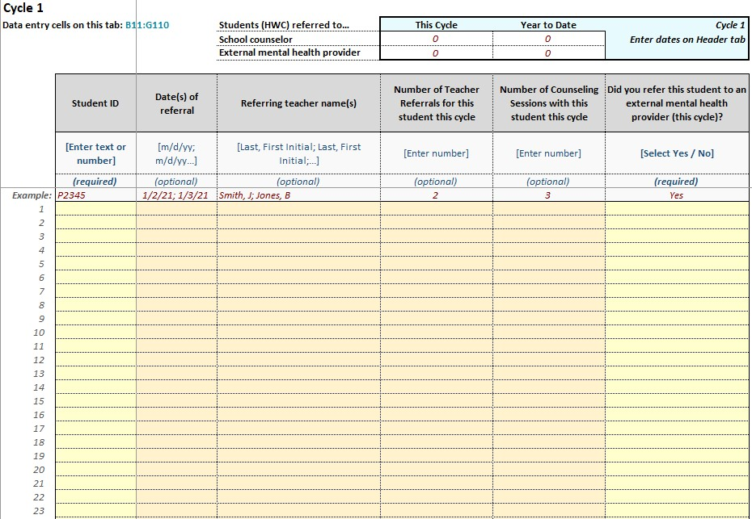
HWC School Counselor Workbook
What is the HWC School Counselor Workbook?
  Excel document that allows school counselors to capture:
  Number of school counselor referrals for students identified for HWC support
  Number of external mental health provider referrals for students identified for HWC support.
  *A paper version of this workbook is available for school counselors to use in place of the Excel file.
What is the purpose of the HWC School Counselor Workbook?
Tab from the HWC School Counselor Workbook
Supports school counselors to document and monitor interactions with students identified for HWC support ​
Notes:
Facilitator notes:
Read talking points and then bullet points under the questions on the slide.
Talking points:
To help schools document and monitor data related to HWC implementation and student outcomes, there are two Excel workbooks. Let’s start by looking at the HWC School Counselor Workbook. Only school counselors are responsible for filling out the HWC School Counselor Workbook.

Slide 30
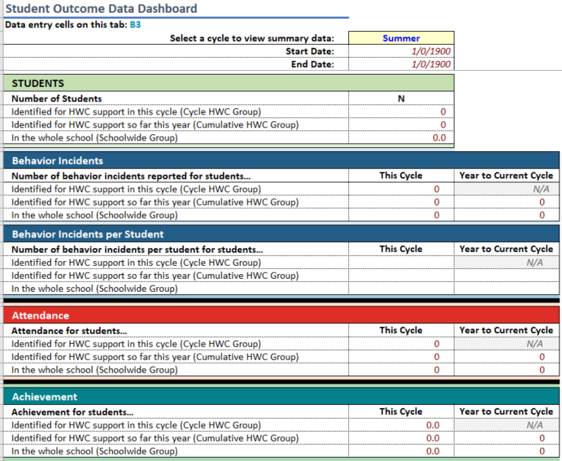
HWC Data Lead Workbook
What is the HWC Data Lead Workbook?
  Excel document that:
  Includes data entry and dashboard tabs
  Allows staff to capture data on:
    HWC notices
    Student outcome data (achievement, attendance, behavior)
    Referrals to school counselors and external mental health providers
What is the purpose of the HWC Data Lead Workbook?
Dashboard tab from the HWC Data Lead Workbook
Supports staff to document and monitor HWC implementation and student outcome data. Dashboard tabs include tables and graphs to support HWC school teams with data interpretation.
Notes:
Facilitator notes:
Read talking points and then bullets under the questions on the slide.
Talking points:
In addition to the School Counselor Workbook, there is a Data Lead Workbook. Only the HWC data lead is responsible for filling out the HWC Data Lead Workbook.

Slide 31
Using the HWC School Counselor Workbook
The HWC School Counselor Workbook includes the following tabs for viewing or inputting information:
    Instructions
    Header
    Summary
    Cycle tabs
The HWC school counselor responsibilities include the following:
    Add student referral information in the workbook
    Share student referral data with the data lead to add to the HWC Data Lead Workbook
    Review data in the “Header” and “Summary” tabs and prepare to share these data during the data review meeting with the HWC school team
Tabs in the HWC School Counselor Workbook
Notes:
Facilitator notes:
Slide is animated. Click once to reveal the first bullet point with the different kinds of tabs in the HWC School Counselor Workbook and then read through the talking points below. Click twice to reveal the responsibilities of the school counselor on the HWC school team and then read through the bullet points.
Talking points:
Each school counselor who works with students identified for HWC support should complete a workbook. This means that if there are three counselors, there will be three separate counselor workbooks actively in use. When you open the HWC School Counselor Workbook, you will see Instructions, Header, Summary, and Cycle tabs, which you see on the bottom of the screen here.
Instructions – This tab provides basic instructions about how to use the workbook. You can find more detailed instructions about how to use this workbook in appendix F of the Guide.
Header – In this tab, school counselors will enter their name, number of cycles, and the start and end date of each cycle. The cycle period should be set by the HWC school team as part of the implementation planning process.
Summary – This tab presents summary data from the workbook, including referrals to school counselors and to external mental health providers for the current cycle and year to date.
Cycle tabs – These tabs are where school counselors enter individual HWC referral data for each cycle. The workbook provides space to enter data for 11 cycles.

Slide 32
Using the HWC Data Lead Workbook
The HWC Data Lead Workbook includes the following tabs for viewing or inputting information:
    Instructions
    Teacher Roster (optional)
    Other Staff Roster (optional)
    Training and Documentation
    Enter Student Data
    Enter Cycle Data
    Implementation Data Dashboard
    Student Outcome Data Dashboard
The HWC data lead responsibilities include the following:
    Fill out data entry tabs in the HWC Data Lead Workbook with implementation and student outcome data
    Review data in dashboard tabs and share these data during the data review meeting with the HWC school team
Tabs in the HWC Data Lead Workbook
Notes:
Facilitator notes:
Slide is animated. Click once to reveal the first bullet point with the different kinds of tabs in the HWC Data Lead Workbook and then read through the talking points below. Click twice to reveal the responsibilities of the HWC data lead and then read through the bullet points.
Talking points:
The HWC data lead uses the HWC Data Lead Workbook to document and monitor overall program implementation and student outcome data. The workbook contains 8 sections, organized across a series of spreadsheets with clearly labeled tabs. In this workbook you'll enter information about the staff in your school (the two roster tabs), track progress towards meeting the HWC training and documentation requirements, enter data about program implementation and student outcomes, and view charts and graphs of your data (the two dashboard tabs). The charts and graphs will support you with meaning-making and deciding on next steps. You can refer to appendix H in the Guide for more instructions on how to use the HWC Data Lead Workbook.
FOR REFERENCE
Instructions – Provides basic instructions about how to use the workbook. Remember, you can find more detailed instructions about how to enter data and use this tool in appendix H.
Teacher Roster – Provides a place to create a list of teachers at your school. This list is then available for you to use when entering a student’s teachers to inform about an HWC notice.
Other Staff Roster – Provides a place for you to create a list of other staff members at your school. This list is then available for you to use when selecting other school staff to notify about an HWC notice.
Training and documentation – Documents the school team’s progress toward completion of necessary HWC training and document preparation. You will be asked to indicate whether you have completed each of the training and documentation activities at the beginning of the program and midway through the program.
Enter Student Data – Provides a place for you to monitor information related to each student identified for HWC support. You will record the student’s ID, the student’s grade, the student’s teachers (and any other staff who should be notified about the HWC referral), and teacher/staff notification dates.
Enter Cycle Data – Provides a place for you to document information on attendance, achievement, and behavior incidents for students identified for HWC support. Data leads in West Virginia will need to pull data from ZoomWV-e to populate cells in this tab. This tab also houses information on counseling and mental health referrals for these students. You will need information found in the School Counselor Workbook to fill in these cells.
Implementation Data Dashboard – Presents summary tables and graphs of HWC referral information, including the number of HWC referrals and the percentage of HWC referrals for which all teachers and all other school staff have been notified.
Student Outcome Data Dashboard – Presents summary tables and graphs for data including behavior incidents, attendance, and achievement.
No data entry is required on the two dashboard tabs. School teams will use the information contained on the two dashboard tabs during their data review meetings.

Slide 33

Using Data to Support Program Improvement: A Guide for Monitoring HWC in Schools (the Guide)
What is the Guide?
  Comprehensive document that includes:
  An overview of using data to inform program improvement
  Detailed instructions on how to use the HWC Excel Workbooks
  Protocols to facilitate data collection and data discussions
What is the purpose of the Guide?
  Supports school teams to monitor program implementation and student outcome data (attendance, behavior, and academic achievement).
Cover of the Guide
Notes:
Facilitator notes:
Read talking points and then read through the bullet points under the questions on the slide.
Talking points:
The Guide supports educators with implementing HWC and using the two HWC Excel Workbooks to document and monitor HWC-related data to promote the use of effective supports and positive student outcomes.

Slide 34
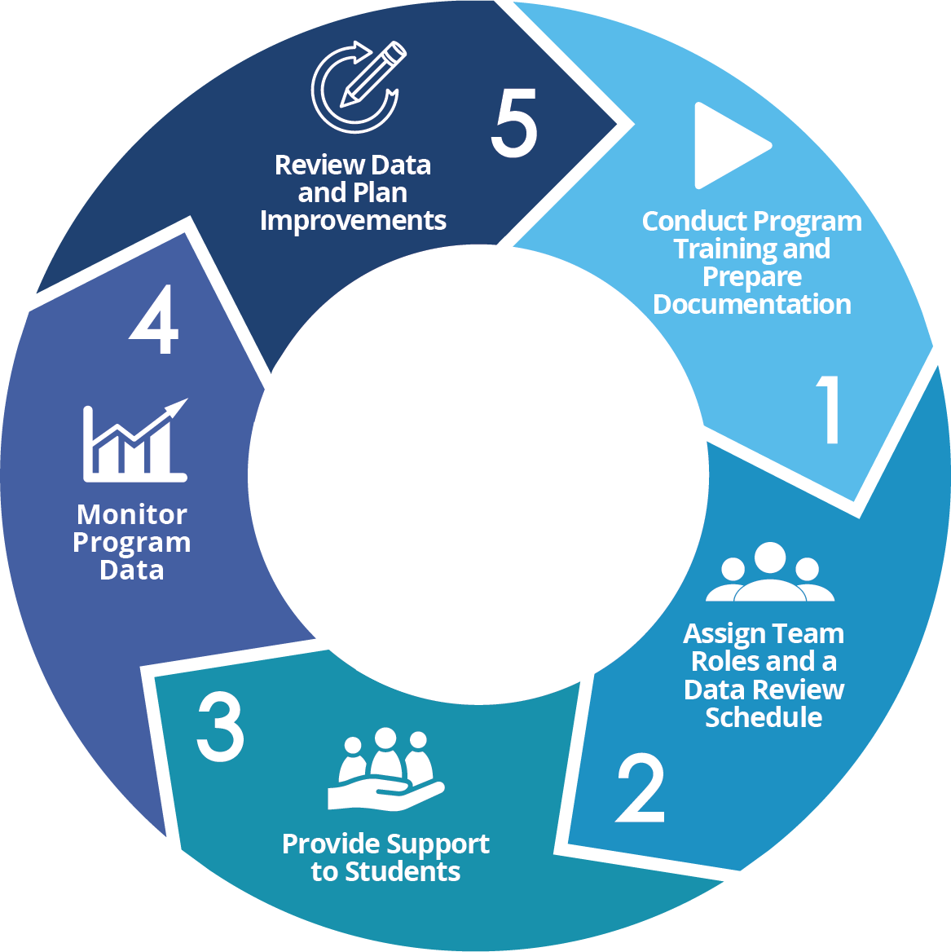
The Five-Step Improvement Process
Notes:
Facilitator notes:
Read talking points.
Talking points:
The Guide describes a five-step continuous improvement approach to program implementation, such that the data-monitoring and review process leads to reflections on program implementation and adaptations in regular cycles throughout the school year. This may look familiar to you based on the information we just discussed about forming school teams and monitoring program data.
The first two steps provide the basics for how schools will get started with the improvement process. They include information on how to prepare for program implementation through trainings and document preparation, how to create the HWC school team, and how to develop a schedule for regular data review meetings. The remaining steps describe how to use the Excel workbooks and detail how the HWC school team will use the data entered into the two workbooks to reflect on HWC implementation and make a plan for next steps.

Slide 35
Appendixes in the Guide
Appendix A: School-Level Logic Model for Handle With Care
Appendix B: Discussion Guide for Teachers
Appendix C: Example Data Review Schedules
Appendix D: Additional Resources for Educators on How to Support Students Experiencing Trauma
Appendix E: Guidance for Monitoring Student Achievement Data
Appendix F: HWC School Counselor Workbook Instructions
Appendix G: Handle With Care Monitoring Sheet for School Counselors
Appendix H: HWC Data Lead Workbook Instructions
Appendix I: HWC School Team Data Review Meeting Discussion Guide
Appendix J: HWC Glossary
Notes:
Facilitator notes:
Read talking points.
Talking points:
The Guide includes a number of appendixes, two of which we have referred to in our discussion of the HWC School Counselor and Data Lead Workbooks. These appendixes are a set of reference documents, including instructions and examples, that will be helpful for you all as you engage in this work.
The appendixes will be particularly valuable as you engage in the nuts-and-bolts work of inputting data into the Excel Workbooks and discussing HWC data to plan for program improvement. We recommend that you return to them often as questions arise.

Slide 36
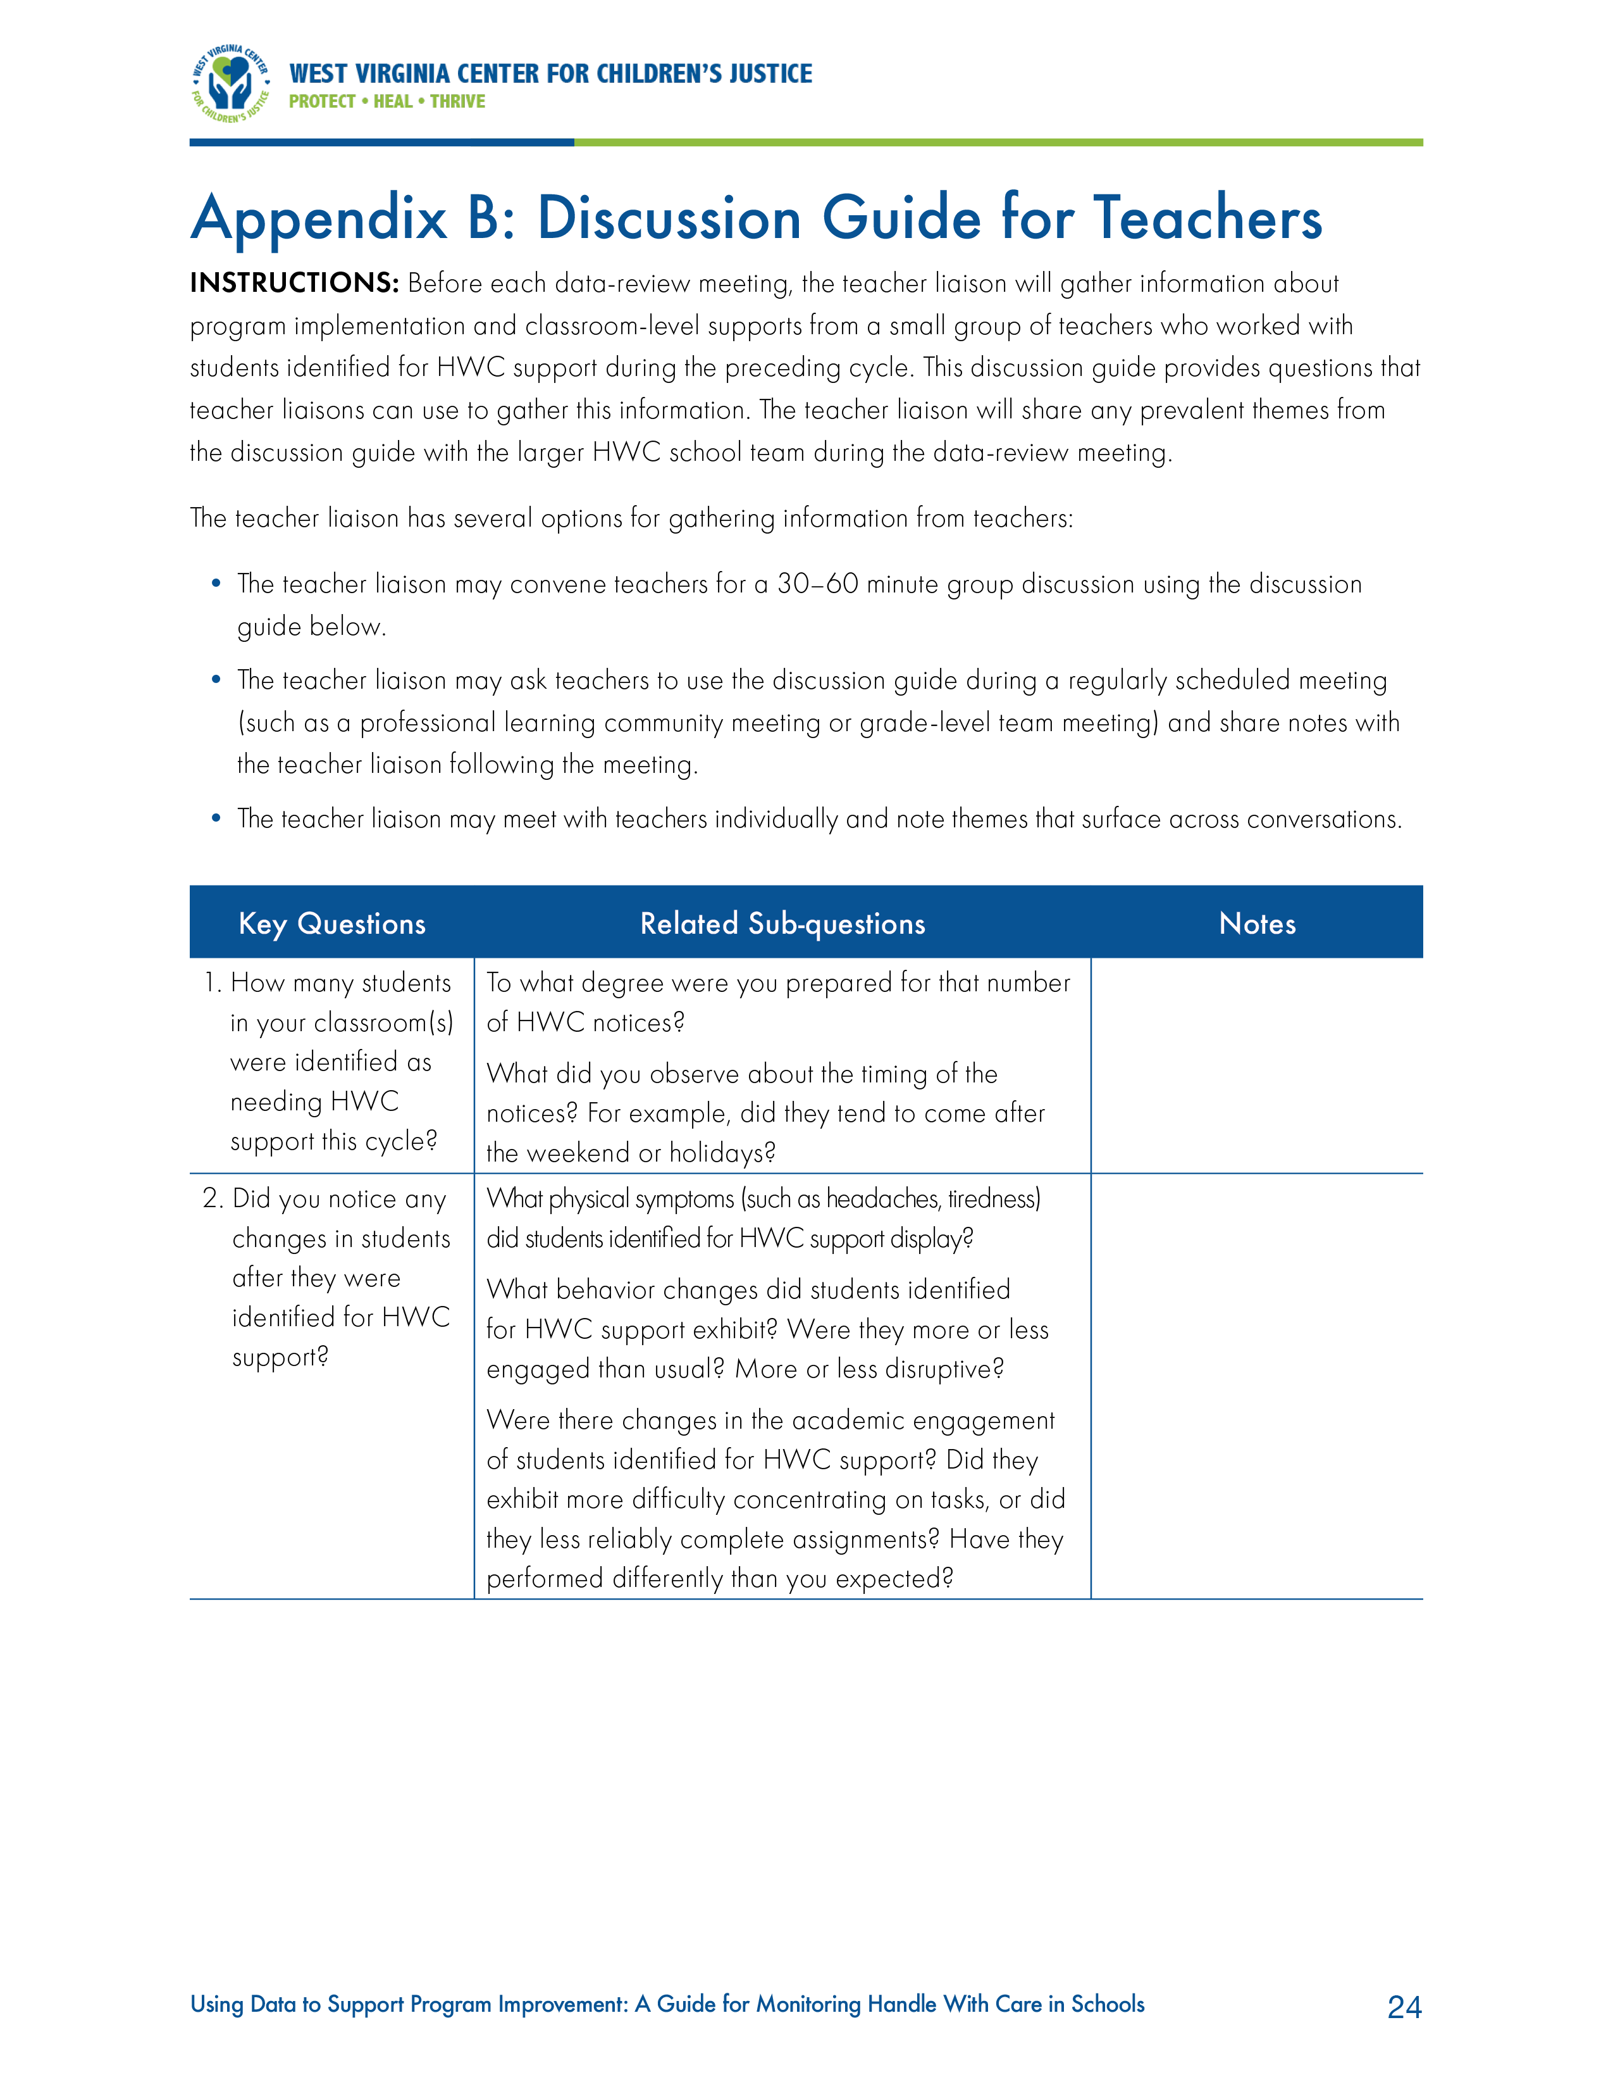
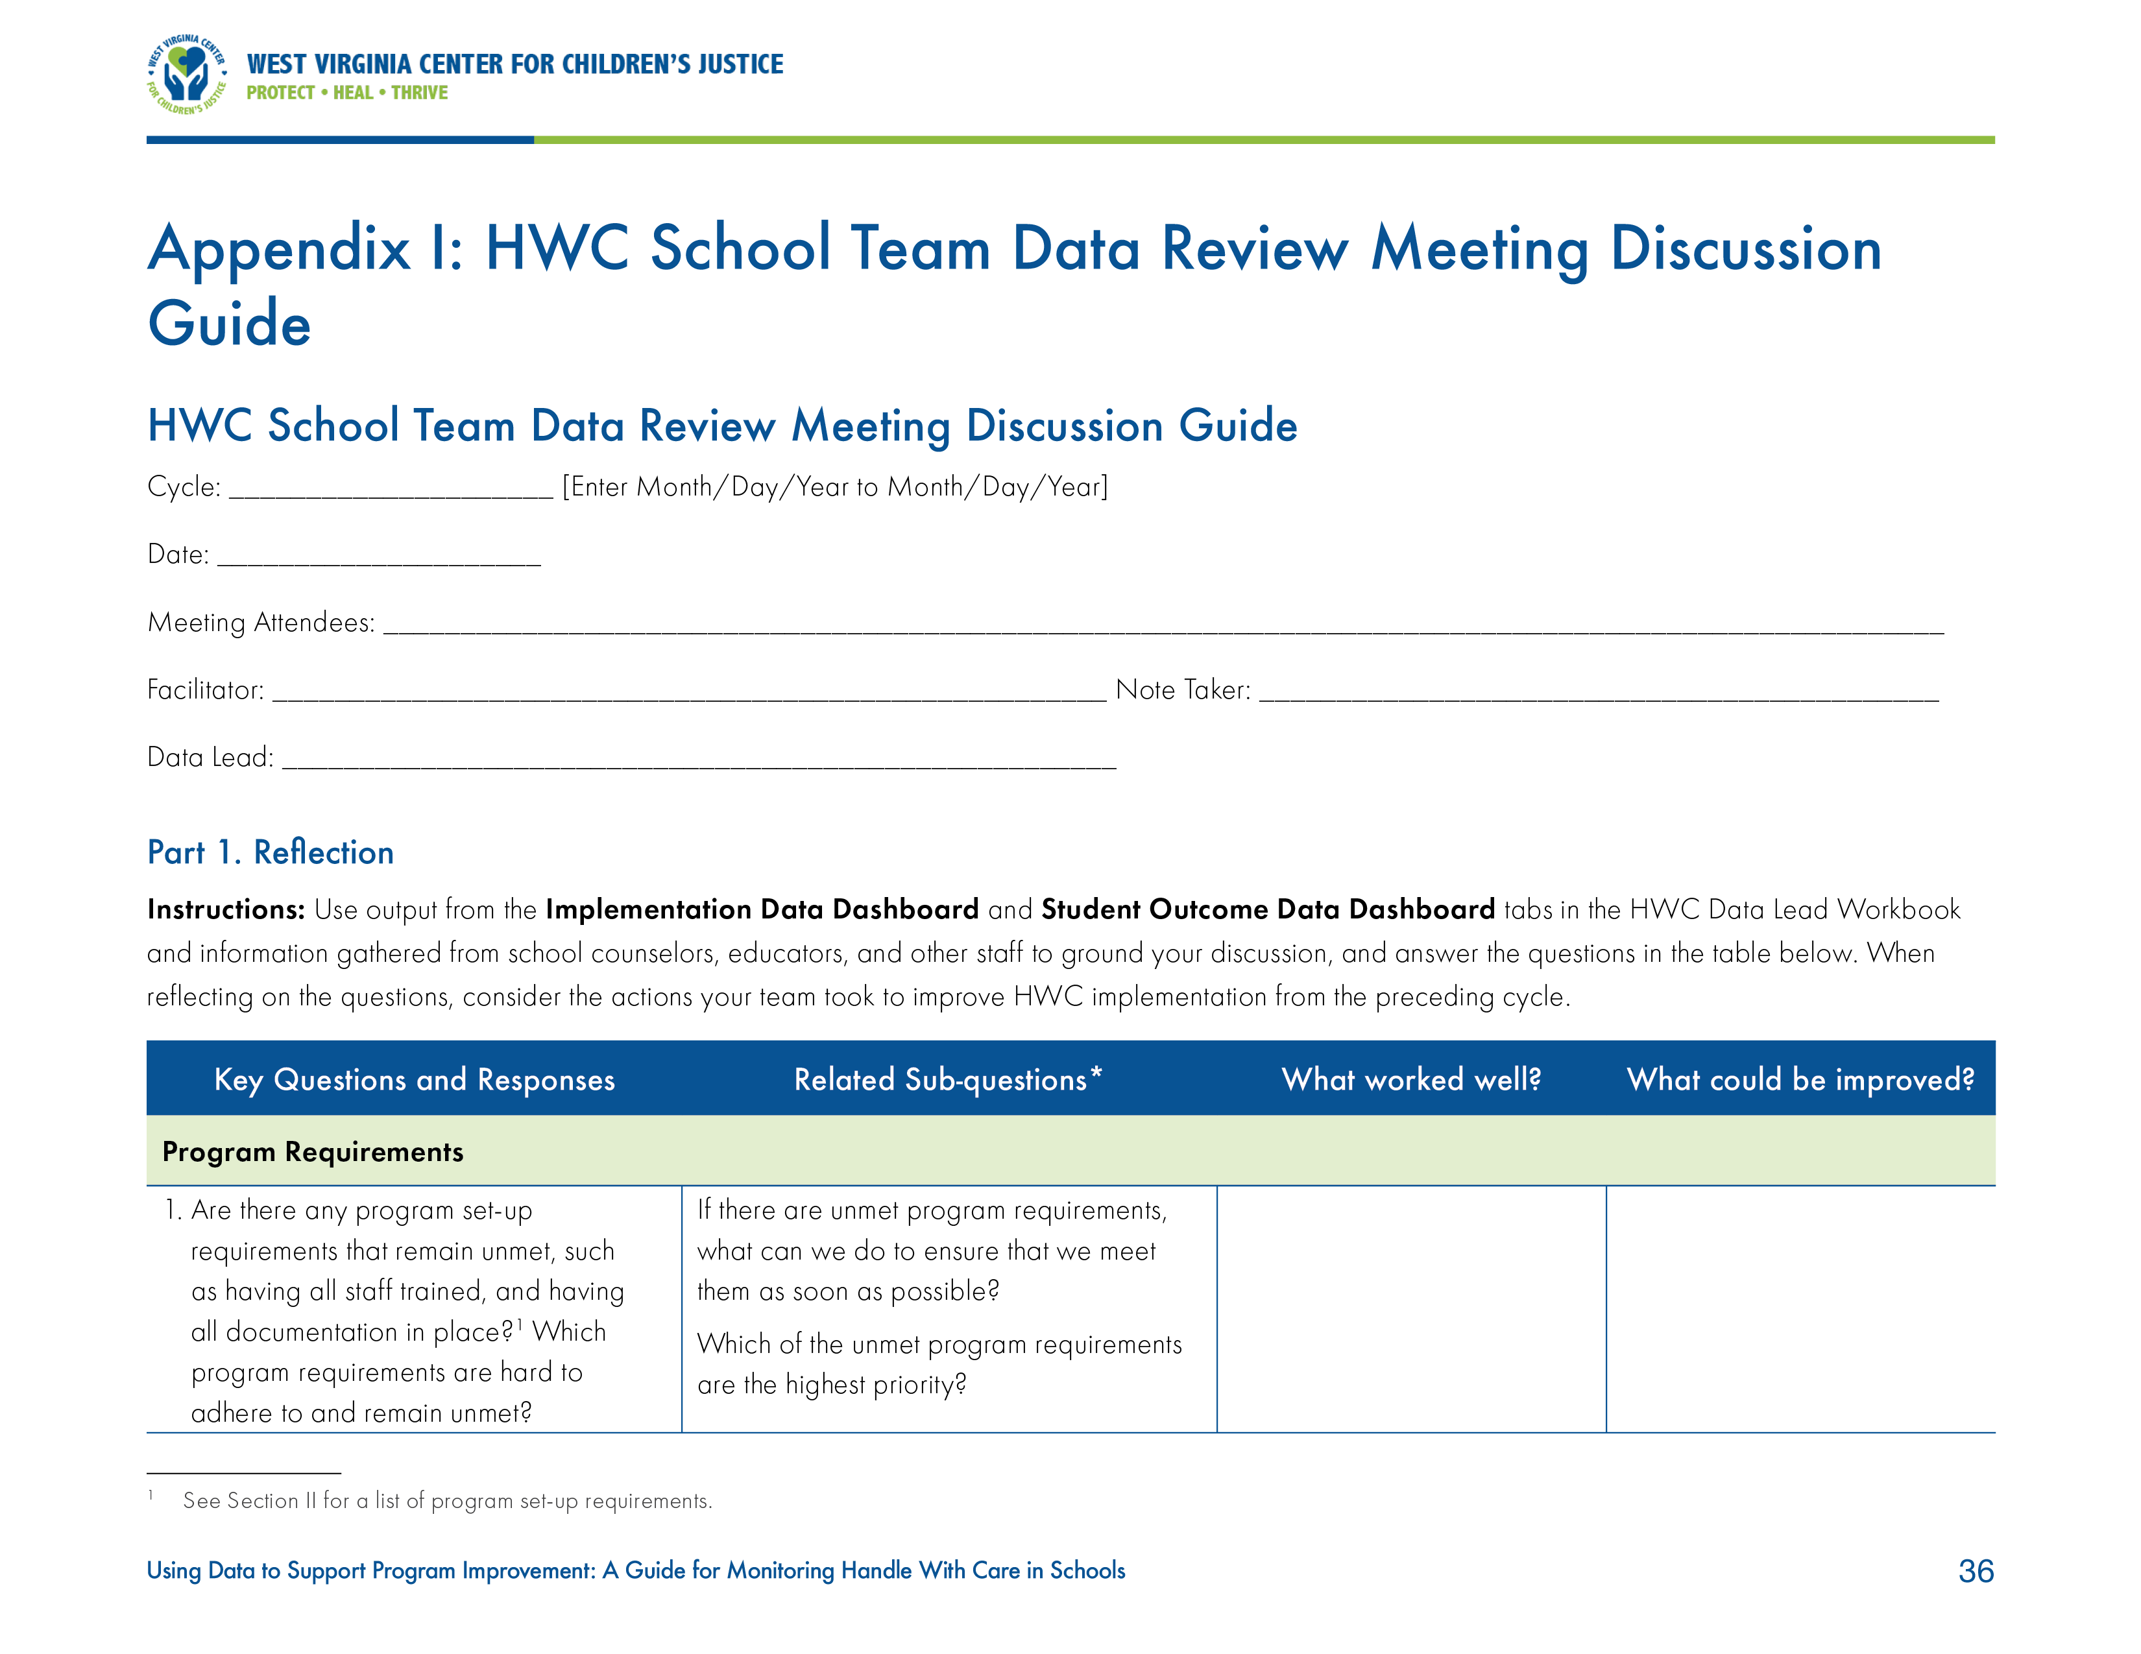
Protocols for discussion
Discussion Guide for Teachers
(Appendix B)
Uses systematic approach for gathering teacher input about implementing HWC
Informs discussion at HWC school team meetings
Data Review Meeting Discussion Guide
(Appendix I)
Uses systematic approach for examining HWC data and student outcome data
Informs how teams review, reflect, and plan
Requires staff assigned to three key roles: facilitator, notetaker, and data lead
Notes:
Facilitator notes:
Read talking points.
Talking points:
We're calling special attention to two other appendixes in the Guide. These appendixes are discussion guides to assist school teams in the continuous improvement process – a Discussion Guide for Teachers and a Data Review Meeting Discussion Guide.
Discussion Guide for Teachers: It is important to collect data from teachers because they are on the front line of HWC implementation. They will receive notifications, observe students, implement trauma-informed strategies to support students experiencing trauma, and refer students to counseling as needed.
Data Review Meeting Discussion Guide: HWC school teams meet regularly (often monthly) to participate in data review meetings. The data review meeting should follow a structure that includes time for review, reflection, and planning. As discussed earlier, HWC school teams should make sure staff members are assigned to the following roles: facilitator, notetaker, and data lead. The questions contained in this protocol are intended to generate productive discussions about what pieces of the program and implementation strategies worked well and what areas require improvement. After answering these questions, teams will be ready to plan for the next month. Ideally, participants will leave with well-identified action steps at the end of their meeting.

Slide 37
Preparing for a Handle With Care Data Review Meeting
Notes:
Facilitator notes:
Read talking points.
Talking points:
We have reviewed the Handle With Care program, the process of collecting and monitoring data, the responsibilities of the HWC school team, and the materials to support HWC implementation and monitoring. An integral part of implementing HWC and using the available materials is the data review meeting, where the HWC school team convenes to discuss data from the previous cycle. Let’s take a look at what each HWC school team member is responsible for to make sure that these meetings are efficient and effective. In this section, we will answer the following questions:
How do HWC school team members prepare for data review meetings?
What are each HWC school team member’s responsibilities?

Slide 38



Preparing for the HWC data review meeting: HWC data lead
The HWC data lead will:
  Input program and student outcome data, including referrals to counseling and external mental health providers, into the HWC Data Lead Workbook throughout a cycle.
  Share the data with the HWC school team facilitator ahead of the data review meeting.
  Review data for the current cycle during the data review meeting, using graphs for ease of understanding, and review longitudinal trends.
Notes:
Facilitator notes:
Read bullet points on slide and then read talking points.
Talking points:
The HWC data lead may select and print graphic displays from the HWC Data Lead Workbook data dashboard tabs to share with the HWC school team and guide their discussion around using data to make program improvements.

Slide 39


Preparing for the HWC data review meeting: School counselor(s)
Each school counselor will:
  Maintain an individual HWC School Counselor Workbook during the school year.
  School counselors may choose to use a paper version of the HWC School Counselor Workbook.
  Input referral data into the HWC School Counselor Workbook throughout a cycle and share those data with the HWC data lead.
The HWC school team school counselor will:
  Review data for the current cycle and prior cycle(s), noting any trends for discussion.
Notes:
Facilitator notes:
Read bullet points on slide.

Slide 40


Preparing for the HWC data review meeting: Facilitator
The HWC school team facilitator will:
  Review the HWC School Team Data Review Meeting Discussion Guide (appendix I) to prepare to lead the discussion.
  Set an agenda for the meeting that includes reports from each of the HWC school team members who have collected data in the last cycle.
  Lead the data review meeting, relying on the data review meeting protocol (appendix I) as appropriate.
  Coordinate with the data lead to review data ahead of the whole-team meeting.
Notes:
Facilitator notes:
Read bullet points on slide.

Slide 41

Preparing for the HWC data review meeting: Teacher liaison
The teacher liaison will:
  Collect information from teachers of students identified for HWC support in the most recent cycle using the Discussion Guide for Teachers (appendix B).
  Share findings during the data review meeting.
Notes:
Facilitator notes:
Read bullet points on slide.

Slide 42

Preparing for the HWC data review meeting: Other team members
Other HWC school team members will:
  Support students identified for HWC support.
  Document any issues or challenges that arise in the HWC notification process.
  Share their own and other educators’ experiences with students identified for HWC support.
  Review data or materials shared in advance of meetings.
Notes:
Facilitator notes:
Read talking points and then bullet points on slide.
Talking points:
Other HWC school team members may include notetakers or members without a specific role.

Slide 43

Conducting the data review meeting
HWC school team members report on data.
HWC school team facilitator walks HWC school team members through the Data Review Meeting Discussion Guide (appendix I).
HWC school team members identify priorities and discuss and decide on next steps.
Notes:
Facilitator notes:
Read bullet points on slide.

Slide 44
Getting Started
Notes:
Facilitator notes:
Read talking points.
Talking points:
So far, this presentation has provided an overview of how to monitor HWC implementation in schools. In this section, we will answer the following questions:
How can schools complete steps one and two of the five-step process?
What steps do schools need to take to begin monitoring HWC using the materials?

Slide 45
How to begin preparing for implementation
Start working through the five-step process.
Lay the foundation for program implementation and monitoring.
Use HWC materials to inform efforts and answer questions.
Notes:
Facilitator notes:
Read talking points.
Talking points:
The first two steps in the five-step process involve laying the foundation for the program implementation and monitoring to run smoothly and successfully. HWC school teams can use the HWC materials to inform the launch of their monitoring efforts and answer any questions about the program and the continuous improvement process they have. HWC school teams can begin implementing by completing steps 1 and 2 of the five-step process.

Slide 46
Step 1: Conduct program training and prepare documentation
Conduct training.
  Put a protocol in place to inform school staff of HWC notices.
  Designate a school contact to receive HWC notices.
Prepare documentation.
  Put memoranda of understanding (MOUs) in place with local participating organizations, as appropriate.
  Create referral forms for teachers to use to send students to school counselors.
  Gather information about external mental health providers to whom counselors can refer students.
  Create parental consent forms for referring students to external mental health providers.
Notes:
Facilitator notes:
Read bullet points on slide and then talking points.
Talking points:
These are recommended training and documentation items that schools can put in place. Some may already be in place at your school, and you may find that there are other forms of training or documentation to add to these lists. You can refer to step 1 on page 5 of the Guide to learn more about this step.

Slide 47
Step 2: Assign team roles and create a data review schedule
Assign HWC school team roles.
Create and commit to a data review schedule.
  Set the regular schedule (the cycle) for the year.
  Schedule internal data review team meetings for the first week after each cycle ends.
Notes:
Facilitator notes:
Read bullet points on slide and then read talking points.
Talking points:
The HWC school team can include school staff from a variety of positions (administrators, teachers, and other support staff). After the HWC school team roles have been assigned, HWC school team members can begin to review the materials that are relevant to their role on the team:
All members can read the Guide for an overview of the HWC program and monitoring implementation and student outcome data.
HWC data leads can review the HWC Data Lead Workbook and the relevant Guide appendixes.
HWC facilitators can review the Data Review Meeting Discussion Guide (appendix I).
HWC school team school counselors can review the HWC School Counselor Workbook.
Teacher liaisons can review the Discussion Guide for Teachers (appendix B).
On the following slide, we will review an example data review schedule. You can refer to step 2 on page 7 of the Guide to learn more about this step.

Slide 48
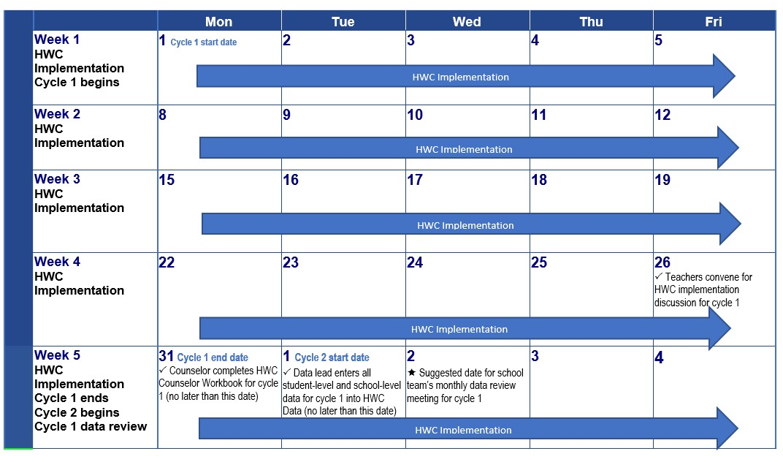
Planning: Example Schedule
Notes:
Facilitator notes:
Read talking points.
Talking points:
This example schedule provides a monthly (four-week) schedule for program implementation, data collection, data entry, and data review. HWC school teams can customize this schedule to meet their local needs and chosen cycle length. While HWC implementation (including communication about HWC notices and referrals to counselors) is ongoing, student outcome data collection, data entry, and preliminary data review ideally will occur as close to the date of the data review meeting as possible at the end of each cycle.

Slide 49
Tips for Program Implementation
Notes:
Facilitator notes:
Read talking points.
Talking points:
We reviewed what you can do to get started on implementing and monitoring HWC in your school. In this section, we will answer the question:
What are some tips for successfully implementing and monitoring HWC?
These tips are informed by the experiences of educators who have already implemented HWC and used HWC data for continuous improvement.

Slide 50

Tips for success
Create form and structure for your project.
Use the materials!
Don’t shy away from the data!​
Accept uncertainty and the need for adaptations over time.
Source: https://411.ca/blog/wp-content/uploads/2011/01/success1-300x225.jpg
Notes:
Facilitator notes:
Read talking points.
Talking points:
Create form and structure for your project.​
Form the HWC project team as recommended!
Discuss and agree upon time commitment, structure, and expectations for everyone involved early on in the project.​
Sometimes people shy away from defining structure and expectations — but don’t. Having solid form and structure makes the difference in the long term.​
Use the materials!
Rely on the materials and trust the process. In time, you will be glad you did.​
Don’t shy away from the data!
The Excel workbook will provide you with useful information to help your school team better understand implementation and student outcome data​. Equipped with such knowledge, you can improve the support you provide students over the course of the school year – before it’s too late.​
Accept uncertainty and the need for adaptations over time.​
“Lean in” on the “messy” process of identifying common problems and developing joint solutions.​
Build in flexibility to pivot and address gaps and issues as they arise.​
Adapt your data-driven decisionmaking guidance over time based on the strengths and areas of growth for the individuals or teams you work with. ​

Slide 51
Wrap-up
Notes:
Facilitator notes:
Read talking points.
Talking points:
We have covered a lot in today’s presentation. In addition to the materials we reviewed, there are other materials available to support you in your implementation of HWC.

Slide 52



Additional materials
Infographic
Webinar
Video
Notes:
Facilitator notes:
Read talking points.
Talking points:
There are more products to support you with implementing HWC and monitoring HWC-related data. Additional materials include an infographic, a video, and a webinar. If you are curious to learn more, check these out!
Infographic: The infographic provides readers with a “snapshot” of Handle With Care and how to implement it, briefly describes the benefits of using data to strengthen supports for students, and provides more information about the types of data to collect and available tools to support data monitoring.
Video: Implementing Handle With Care: A Data-Driven Approach. The video provides viewers with information about the HWC program, what resources are available to support schools with program implementation, and how implementing the program and using the accompanying materials can support schools and the students they serve. It features Andrea Darr, the founder of HWC, and two educators who piloted the materials in counties in West Virginia.
Webinar: Introducing New Handle With Care Program Materials: Monitoring Implementation and Student Outcomes in Schools. The webinar provides viewers with an overview of the materials and develops educators’ ability to use data for decisionmaking as it relates to the Handle With Care program.

Slide 53
Accessing HWC materials
  Regional Educational Laboratory (REL) Appalachia website
    https://ies.ed.gov/ncee/edlabs/regions/appalachia/events/event_10-13-21_handle-with-care-resources.asp
    West Virginia Center for Children’s Justice (WVCCJ) website
    http://handlewithcarewv.org/
  West Virginia Department of Education (WVDE) website
    https://wvde.us/
Notes:
Facilitator notes:
Read talking points.
Talking points:
All of the materials are free and publicly available at the above websites, and we hope that you will share them broadly with your networks.

Slide 54

Questions?
Notes:
Facilitator notes:
Ask participants if they have any questions.

Slide 55
Contact Information:
[insert facilitator contact information]
Notes:
Facilitator notes:
Insert your contact information on this slide. Read talking points.
Talking points:
Here is my contact information.

Slide 56

Thank you
Source: https://img.rawpixel.com/s3fs-private/rawpixel_images/website_content/job29abatch5-s58-thankyou-04.jpg?w=800&dpr=1&fit=default&crop=default&auto=format&fm=jpg&q=75&vib=3&con=3&usm=15&ixlib=js-1.1.1&s=056d1d2193f895f0e0495acd5665e507
Notes:
Facilitator notes:
Read talking points.
Talking points:
Today we learned about what the Handle With Care program is, how to monitor HWC data, how to prepare for and conduct a data review meeting, and what the next steps are to get ready for implementation and monitoring. Thank you for participating in this training and learning more about how to support students who may be experiencing trauma.

